Slide 1




Python Programming Summer Camp
Class # 2
Variables and Decision Making
By Asim Munawar

Slide 2


What will this Do?
# This is a nice code
name = “Asim”
print(name, “ like Maths. He knows that 3 x 3 = ”, 3*3)

Slide 3
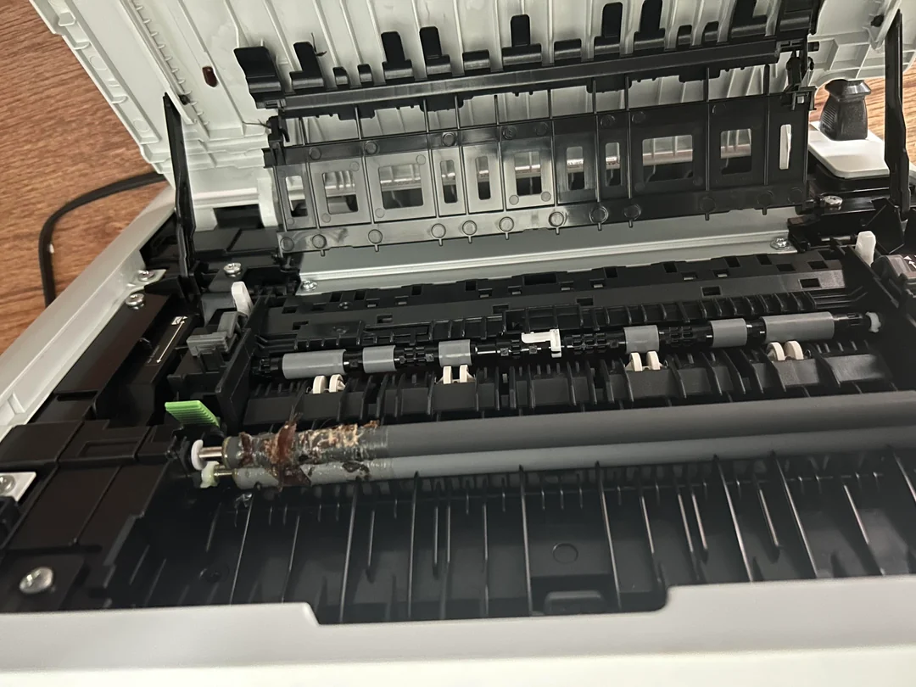

Why Error in code is called a Bug?

Slide 4
10 PRINT "ASIM"
20 GOTO 10
Fun Example
I wrote my first program when I was 6 years old.
The year was 1987?
How old am I?
print("Our teacher wrote his first program in 1987.")
print("He is ", 6 + (2025 - 1987), " years old.")

Slide 5


Course Plan
Lesson 1: Printing Fun – Say Hello to Python
Lesson 2: Variables – Remembering Things in Code
Lesson 2: If/Else – Making Decisions
Lesson 3: Loops – Doing Things Again and Again
Lesson 4: Build a Mini Game – Guessing or Quiz
Lesson 5: Lists – Collecting Many Things
Lesson 6: Functions – Teach the Computer a New Trick
Lesson 7: Files – Saving and Reading Data
Lesson 8: Simple App with Gradio – Make Your Own Tool
Lesson 9: Final Project – Build and Present Your App

Slide 6
What is a Variable?
A variable is like a labeled box that stores a value — like a name, number, or emoji — so we can use it later.
name = "Umar"
age = 12
emoji = "🎮"

Slide 7
Rules for Variables
Must start with a letter or _
Can have letters, numbers, and _
No spaces or special characters like @, !, -
Use lowercase and _ to separate words: favorite_game
✅ Valid: score, player_name, emoji1
❌ Invalid: 1score, player-name, my score

Slide 8
Using Variables in Print
name = "Afan"
print("Hello", name)
city = "Karachi"
print("I live in", city)
score = 10
print("Score is", score)
score = 15
print("New score is", score)

Slide 9
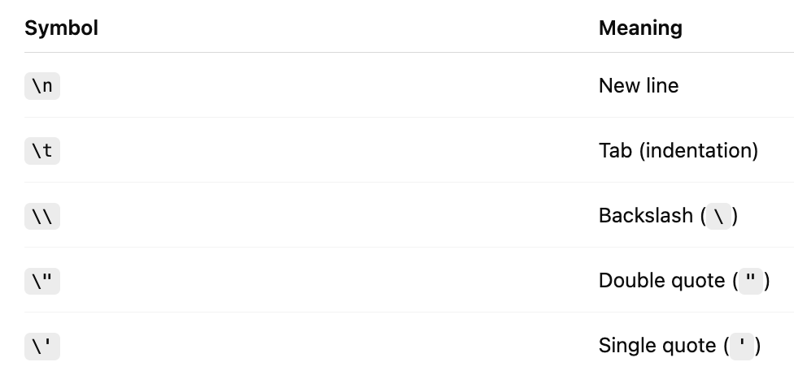
Advanced Print
# New line example
print("Hello!\nWelcome to Python!")
# Tab example
print("Name:\tAli")
print("Age:\t12")
# Backslash example
print("This is a backslash: \\")
# Double quotes inside a string
print("He said, \"Let's learn Python!\"")
# Single quote inside a string
print('It\'s a great day!')

Slide 10



Introduction to If/Else
if/else - lets the computer make decisions
Indent is important
age = 13
if age >= 13:
print("You are a teenager!")
else:
print("You're still a kid!")

Slide 11

How Many Decisions Humans Take in a Day?
35,000+

Slide 12


Types of Comparisons
== (equals)
!= (not equal)
< (less than)
> (greater than)
<= (less than or equal to)
>= (greater than or equal to)

Slide 13

if/elif/else
mood = "happy"
if mood == "happy":
print("😊 Keep smiling!")
elif mood == "sad":
print("😢 It's okay to feel sad sometimes.")
elif mood == "angry":
print("😡 Take a deep breath.")
else:
print("😐 Hope your day gets better!")

Slide 14

Can we compare Words?
word = "zebra"
if word > "monkey":
print(word, "comes after monkey in the dictionary.")
elif word < "monkey":
print(word, "comes before monkey in the dictionary.")
else:
print("You typed monkey exactly!")

Slide 15

Advanced Example
name = "Ali"
score = 87
print("Hello", name + "!")
if score >= 90:
grade = "A"
message = "🌟 Excellent work!"
elif score >= 80:
grade = "B"
message = "👍 Great job, keep it up!"
elif score >= 70:
grade = "C"
message = "🙂 Not bad, you can do even better!"
elif score >= 60:
grade = "D"
message = "😐 Try to work a bit harder."
else:
grade = "F"
message = "😞 Let's review and try again!"
print("Your grade is", grade)
print(message)

Slide 16

Advanced Example
1. Addition:
15 + 4 = 19
2. Subtraction:
15 - 4 = 11
3. Multiplication:
15 * 4 = 60
4. Division (/):
15 / 4 = 3.75
5. Integer Division (//):
15 // 4 = 3
6. Modulus (%):
15 % 4 = 3

Slide 17
Homework
1: Even or Odd
Create a variable `num` and print whether it is even or odd using `%`.
Example:
num = 8
# if num is divisible by 2, it's even
# Hint: use Modulus
---
2️⃣ Voting Age Checker
Create a variable `age`.
Print "You can vote!" if age is 18 or older, else print "You are too young to vote."
Example:
age = 14
---
3️⃣ Mood Bot
Use a variable `mood` with values like "happy", "sad", or "bored".
Print a different message for each using if, elif, and else.
Example:
mood = "bored"
---
4️⃣ Temperature Advisor
Create a variable `temp` (temperature in °F).
Print one of the following based on value:
- "It's hot!" if temp > 85
- "It's nice outside." if 60–85
- "It's cold!" if below 60
5️⃣ Word Battle
Set two variables:
word1 = "cat"
word2 = "dog"
Use if/else to compare them and print which comes first alphabetically.
---
🌟 Bonus Challenge: Grade Feedback
Create a variable `score`.
Use if-elif-else to print the grade and a fun message:
- A (90+): "Excellent!"
- B (80–89): "Great job!"
- C (70–79): "Good effort"
- D (60–69): "Keep practicing"
- F (<60): "Don't give up!"

Slide 18


Thank You

